Slide 1










55866 Data Science
Telehealth & Data
Presented By:
Elior Sastiel, Dan Simhon & Roie Cohen

Slide 2

Telemedicine holds great potential for reducing the variability of diagnoses as well as improving clinical management and delivery of health care services worldwide by enhancing access, quality, efficiency, and cost-effectiveness
In particular, telemedicine can aid communities traditionally underserved – those in remote or rural areas with few health services and staff – because it overcomes distance and time barriers between health-care providers and patients.
Further, evidence points to important socioeconomic benefits to patients, families, health practitioners and the health system, including enhanced patient-provider communication and educational opportunities.

Slide 3
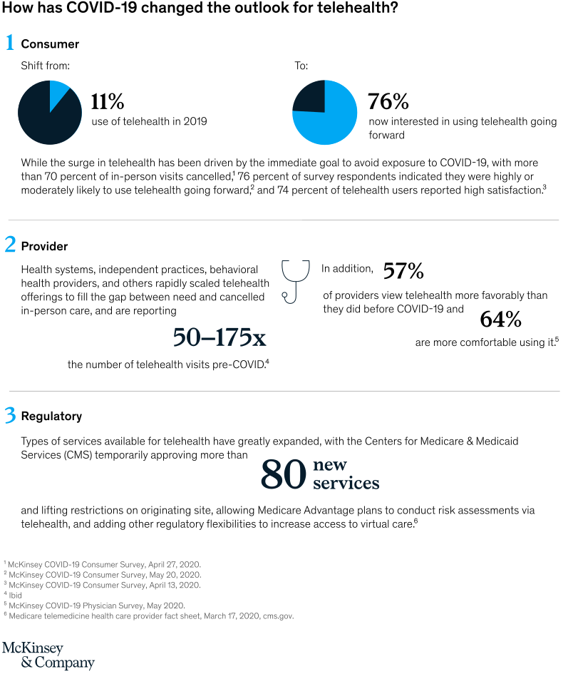


Slide 4
Our Research Question
Can a disease be predicted according to self reported symptoms

Slide 5
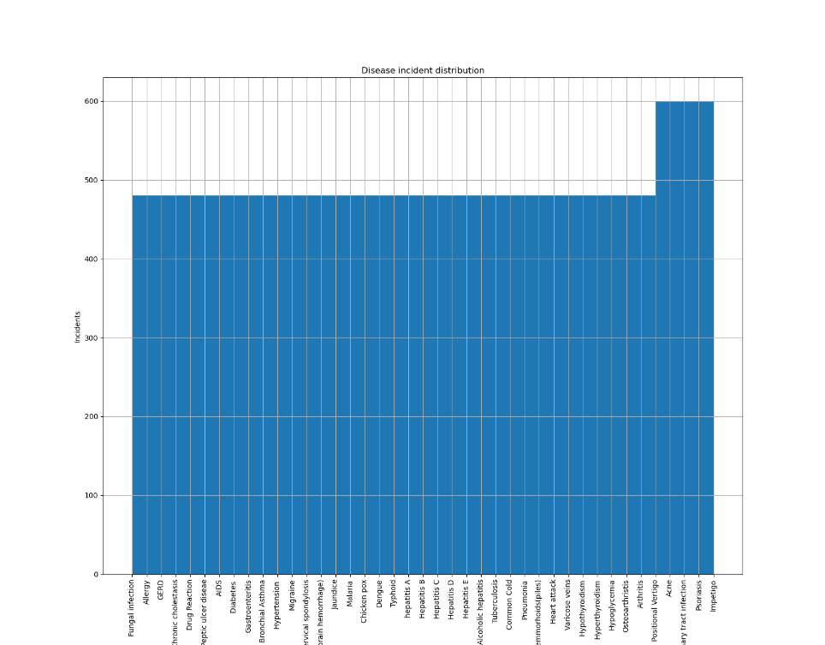

The Dataset
Disease Symptom Prediction - Kaggle
Dataset.csv
Disease Description.csv
For each disease in the dataset a matching text file containing information about the disease by Mayo Clinic
The information includes information such as Causes, Risk Factors, Treatment
4920 incidents of one of 41 listed diseases, each incident lists up to 17 symptoms out of 132 possibilities.
The dataset is almost uniformly distributed with about 500 incidents per disease

Slide 6
Dataset Distribution
First stage after cleaning the dataset was to better understand the content and distribution of the dataset
Since the dataset represents information in 132 space, we used dimensionality reduction techniques to view the data in a 2 dimension plot.
Using these techniques we can also detect if any clusters exist within the dataset on a lower dimension representation and therefore base prediction on less features.
2 algorithms were selected :PCA and TSNE

Slide 7
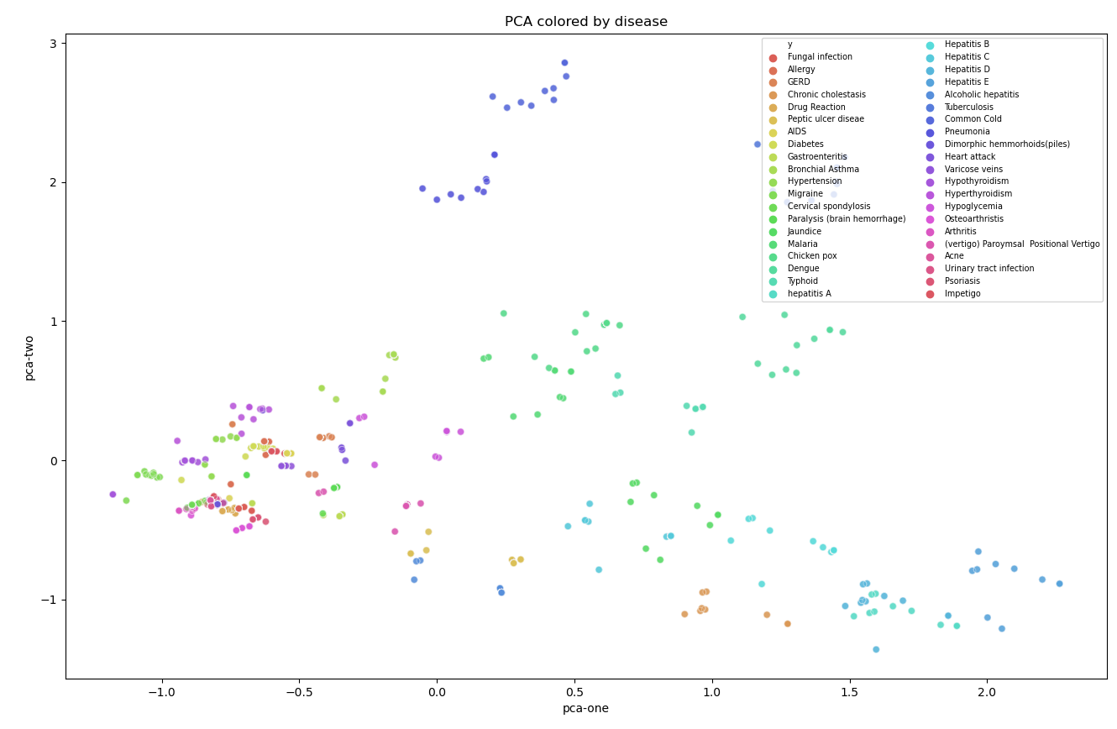
PCA
In the figure to the right we can see the samples of the dataset each one colored according to the disease it relates to using the first 2 components of the PCA the explained variation by the 2 components is 0.12 and 0.10.
Although some diseases do appear to be separated, most of the samples are grouped together and can’t be separated using 2 components.
“Winter Diseases”:
Common Cold
Pneumonia
No Common cause:
Chickenpox,Typhoid, Dangue, Malaria
Liver Diseases: Hepatitis variants Chronic Cholestasis Jaundice

Slide 8
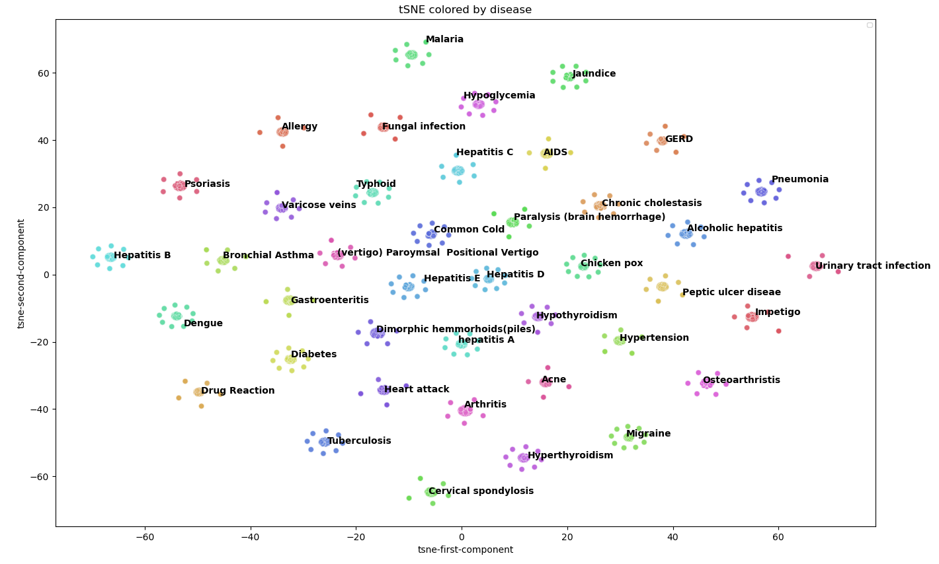
tSNE
t-SNE reduction to 2 components yields perfect results with distinctable separation between the different indications
This result suggests that our dataset is overfitted due to the high dimensionality and unique indication to features ratio.

Slide 9
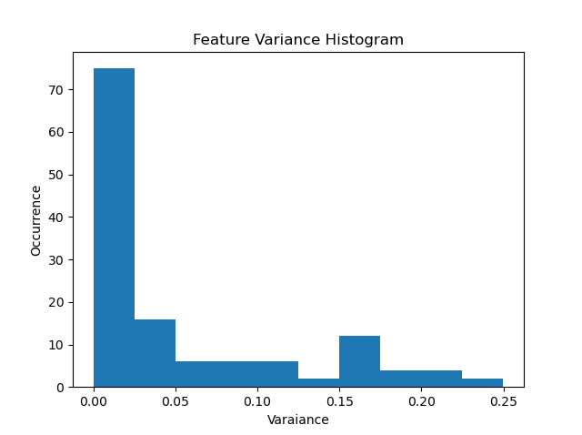
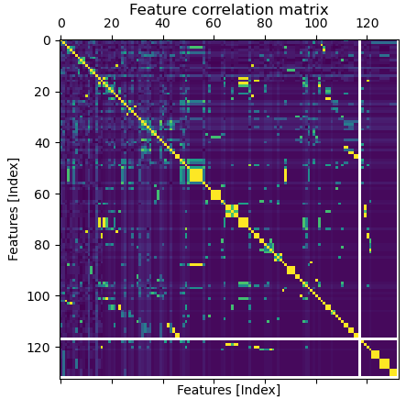
Overcoming Overfitting
Since our goal is to be able to generalize self reported which are subjective and many times common between indications, we need to establish a way of reducing the features so that they generalize to our requirements.
In order to do so we assessed the features in 2 methods:
Variance of features to detect features which are related to a small subset of the diseases or non subjective
Correlation between features finding those who can be inferred from one another
Features relating to approximately only one condition
Selected Cutoff

Slide 10
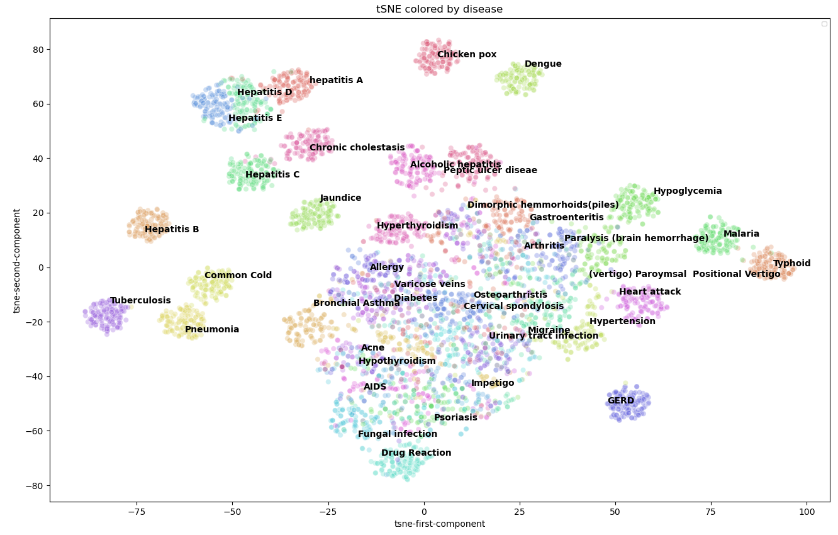
tSNE on the reduced dataset
Dataset was reduced to 30 features and we can see that the data now is less obviously separated
There are some nice clusters around Liver diseases (Hepatitis, Chronic cholestasis and Jaundice)

Slide 11
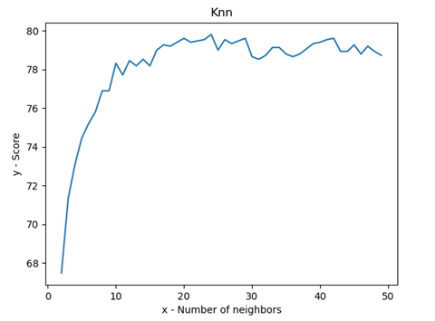
KNN
For the beginning, we decided to run the simplest classification algorithms - KNN.
First – we run KNN on the Data before we dropped irrelevant features, the score was 1.
In one hand the result is good but data was not so difficult.
So we dropped some features, and we run the KNN again and the result is shown in the chart
We split the data to 70% train and 30% test.

Slide 12
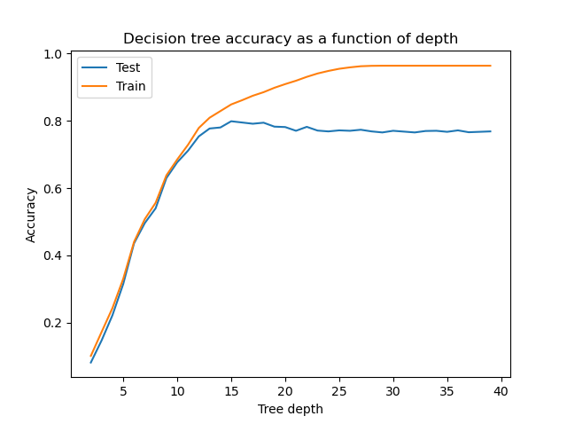
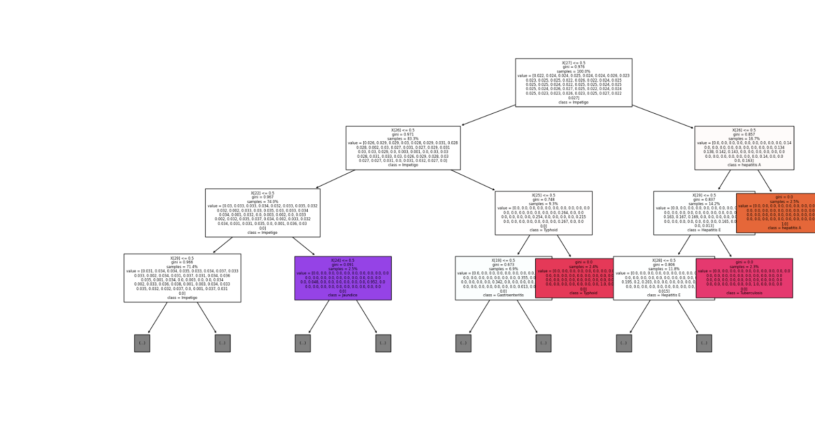
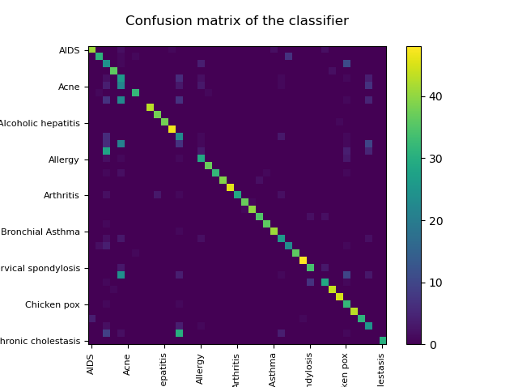
Decision Tree
Overfitting
Selected tree depth of 12 to avoid overfitting and underfitting
Accuracy of the model is 75% by using a subset of the test data ad validation
Under fitting

Slide 13
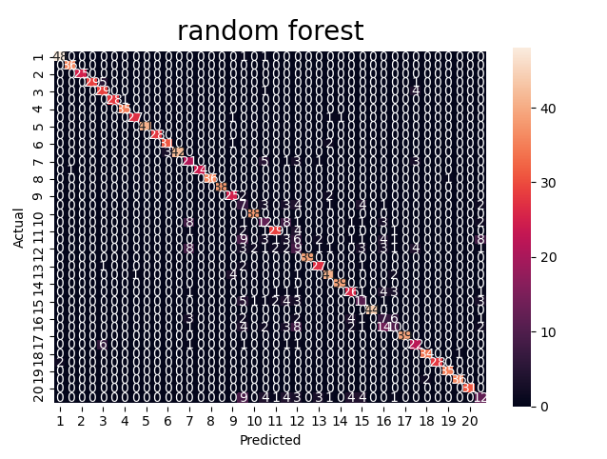
Random forest
After testing several number of estimators, we decided to choose 100.
Accuracy of the model is 80%

Slide 14
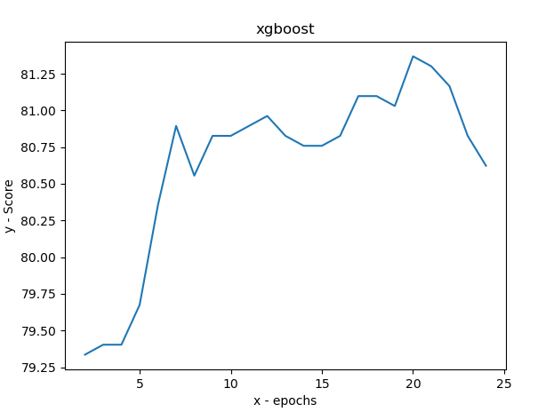
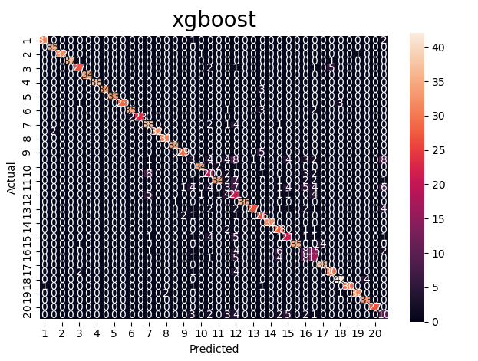
xgboost
To avoid overfiting we had to choose epochs number.
The best result we can see at the chart is 20.
Accuracy of the model is 81.25%
Better than Random forest but not a significant improvement

Slide 15
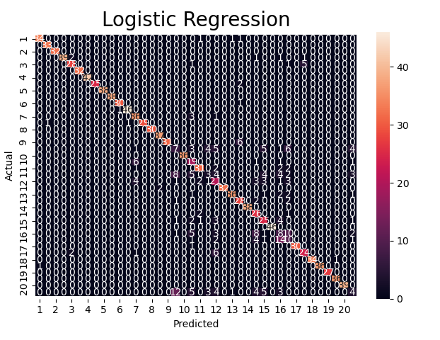
Logistic Regression
Logistic Regression predict the highest accuracy, but again it wasn’t significant improvement from Xgboost.

Slide 16
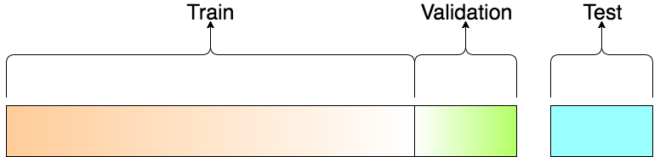
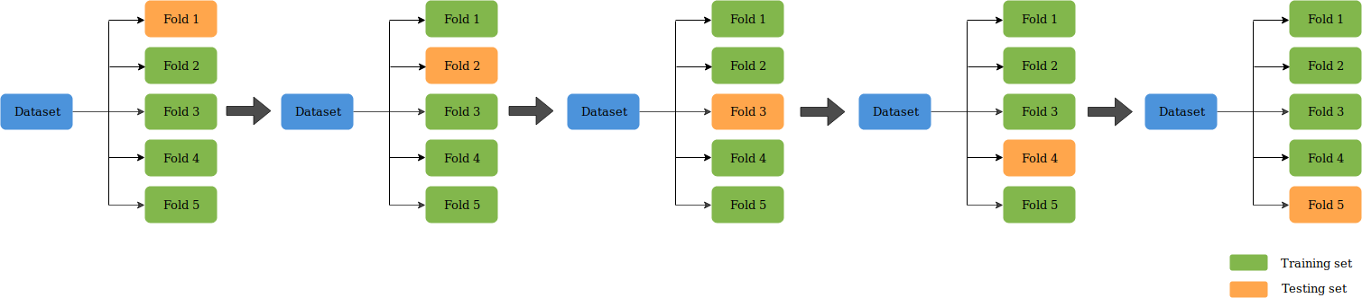
Methodology to Estimate Classifiers
Validation dataset is used to optimize model learning parameters and is regenerated for each fold.
Test dataset is used to test the score against the best fitted model and compared to the average score of the folds
In general we’ve found that all models yield equivalent results between test dataset and average accuracy score

Slide 17
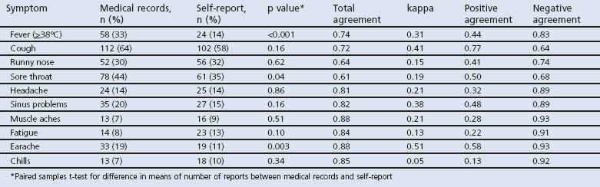
Self-Reporting vs Professional Assessment
Since self reporting relays on subjective measures and not validated tests there is an issue of over estimation and under estimation of symptoms as reported by patients in comparison to professional assessment
Barbara, A. M., Loeb, M., Dolovich, L., Brazil, K., & Russell, M. (2012). Agreement between self-report and medical records on signs and symptoms of respiratory illness. Primary care respiratory journal : journal of the General Practice Airways Group, 21(2), 145–152. https://doi.org/10.4104/pcrj.2011.00098

Slide 18
Prediction Stability & Feature Selection
Simulating the symptom self reporting under estimation and feature selection to better understand the classifier stability.
The method we used is to randomly remove features per sample to simulate the symptom reporting under estimation and removing a feature to better understand the importance of all features
Feature Removed (Mean) | Reported Symptom Removed | Result | Method
79% | 25% | 79% | K-NN
81% | 10% | 81% | XgBoost
83% | 8% | 83% | Logistic Regression
80% | 13% | 80% | Random Forest
76% | 12% | 75% | Tree Model

Slide 19
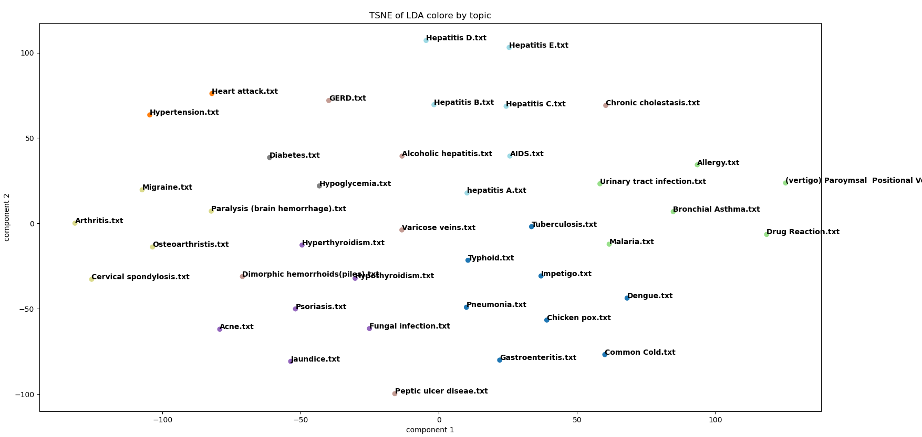
Future Overcoming by using LDA
A suggested approach to overcome a patients self reporting estimation is to use a preprocessing stage categorizing the disease into a group and later on using a classifier in order to distinguish from within the group. Basing prediction on a journal rather than simple symptom reporting might yield better results.
Mayo clinics website provides detailed information regarding each indication including cause, symptoms and treatment.
Non Viral
Virus Based
The image illustrates the issue of relying only on symptoms. Although all Hepatitis types of common symptoms the alcoholic type is cause by excessive drinking whereas the others are viral

Slide 20
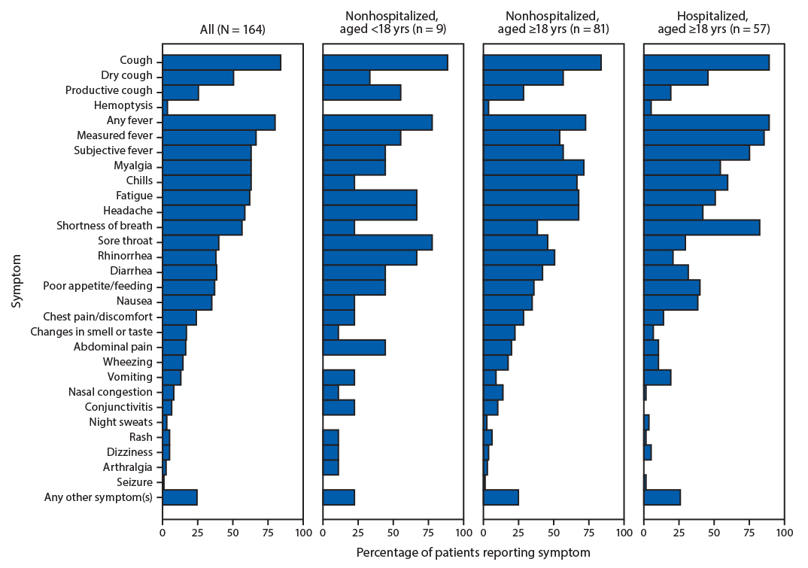
Covid-19 Classification – Generalization
Subset 2 | Subset 1
Typhoid | Bronchial Asthma | K-NN
Typhoid | Bronchial Asthma | Logistic Regression
Pneumonia | Bronchial Asthma | Random Forests
Malaria | Bronchial Asthma | XgBoost
Typhoid | Paralysis (brain hemorrhage) | Decision Tree
Subset 1
Subset 2
Burke RM, Killerby ME, Newton S, et al. Symptom Profiles of a Convenience Sample of Patients with COVID-19 — United States, January–April 2020. MMWR Morb Mortal Wkly Rep 2020;69:904–908.

Slide 21
Summary
Prediction based on self reported symptoms is a difficult task with no more than 83% accuracy which might not be good enough for medical diagnosis but has some benefit as a triage tool for further assessment by a physician
2 issues arise in the classification, first is the over/under estimation of symptoms and second is the similarity of symptoms between diseases which have a different root cause
The following are suggested methods which might to achieve better results if employed.
Adding Objective measures
Type 1 /Type 2 Error
The development of mobile devices capable of measuring physiological signals can contribute to the dataset
Journal Reporting
Adding a measure of fatality between classifications due to
Mis-treatment or wrong treatment Doing so will enable us to estimate the error type and ROC for each indication
Text mining as a preprocessing stage to extract a category of the disease before further classification
Scaling of Symptoms
The dataset currently is composed of binary representation of symptoms per indication. Adding severity of symptoms or continues values (Such as for fever) could help better classify

